Slide 1
Back from the brink
What to do when a once-successful campaign tanks
Andy Grant - Sacred Heart Mission
Dan Tunley - Parachute Digital

Slide 2
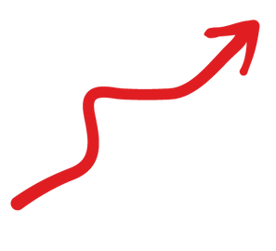
Sacred Heart Mission
2017
2022
$361k from appeals
$29k in major gifts
$905k from appeals
$1.1m in major gifts

Slide 3
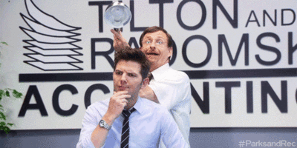
HMM...
HOW ELSE CAN WE ACQUIRE DONORS ?

Slide 4
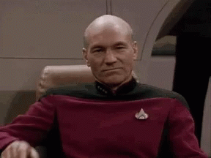
Hey
Shanelle, Can we do
that too…?

Slide 5
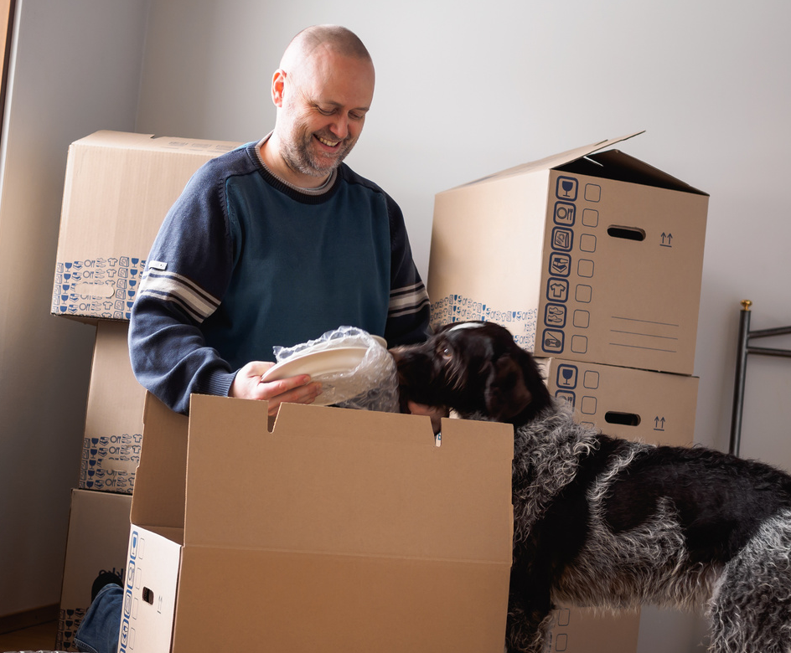
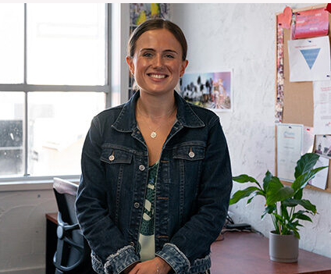
MAKE A HOUSE A HOME
Campaign supporting vulnerable people through the pandemic
Piggybacking off Government support
Expand an existing SHM service
A successful shoulder appeal
Tangible/realistic asks

Slide 6
MAKE A HOUSE A HOME Online
A $20k pilot campaign in April 2021 with a two-fold approach:
Conversion – overt donation ask
Remarketing/nurture – to RG
Key objective to inform viability for future rollout of a digital acquisition campaign.
Donors targeted through social media.

Slide 7
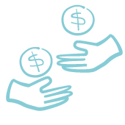
THE RESULTS
$6,500 media spend
119 one-off gifts
13 monthly gifts
$13,949 raised
$49 cost per donor
Year 1 Return on ad spend = 2.64

Slide 8
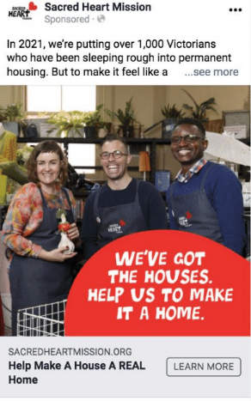
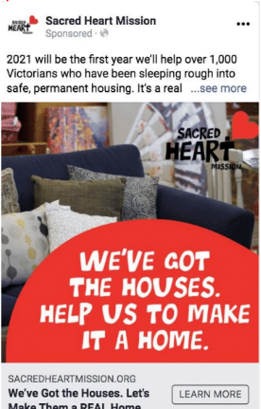
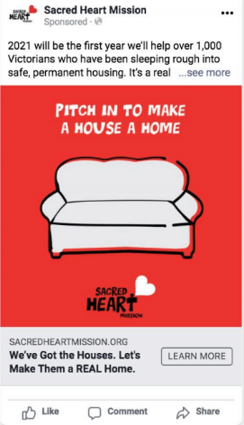
THE RESULTS
9 (8%) donations
$1,030 raised
6 (5%) donations
$699 raised
84 (73%) donations
$9,638 raised

Slide 9
Onwards and upwards...
A new campaign for 2022
Build on solid foundations. Develop an always-on campaign.
Transition RG acquisition
The strategy
New case for support
New RG specific proposition
Pivot away from crowdfunder style to show long-term, ongoing need
Notes:
Let’s take a leap. Let’s scale up. Let’s see what we can do with more budget.
BUT also!!
SHM wanted to build a long term, sustainable income stream so that meant RGs
Which sounded GREAT! We have a proven concept to build on.
BUT. We had to make some tweaks
The shift to RG meant we needed a new to case for support. Something to show ongoing need that would support the monthly donation ask
That meant we had to rephrase the ask, and move away from the crowdfunder.
- 5 people each week = 20/month
-

Slide 10
And the results...?

Slide 11
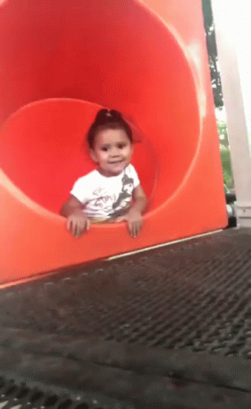
it was totally great and awesome
OK BYEEEE

Slide 12
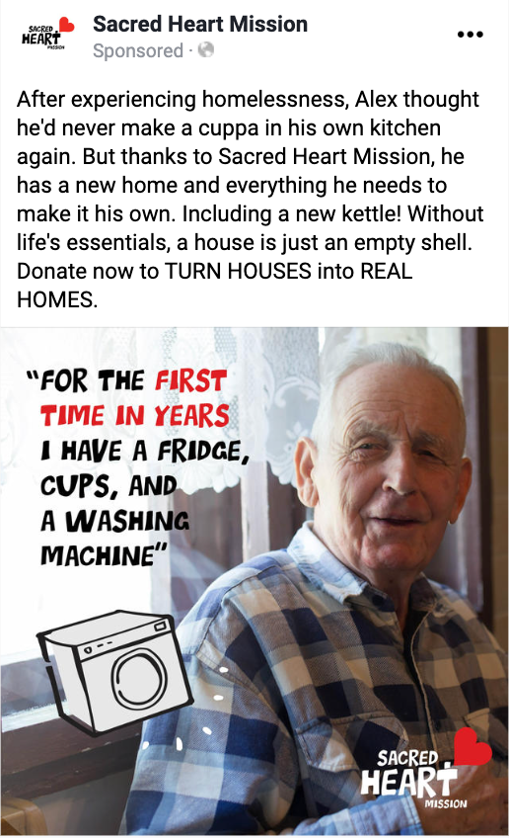
THE RESULTS
$5,800 media spend
8 one-off gifts
2 monthly gifts
$630 raised
$582 cost per donor
4 donations
$161 CPA
Year 1 return on ad spend = 0.12

Slide 13
Not despite trying
Back to cash ask
Geo targeting
Landing page changes
Dollar handle testing
Image vs. Video
Animations
Hope vs. Fear

Slide 14
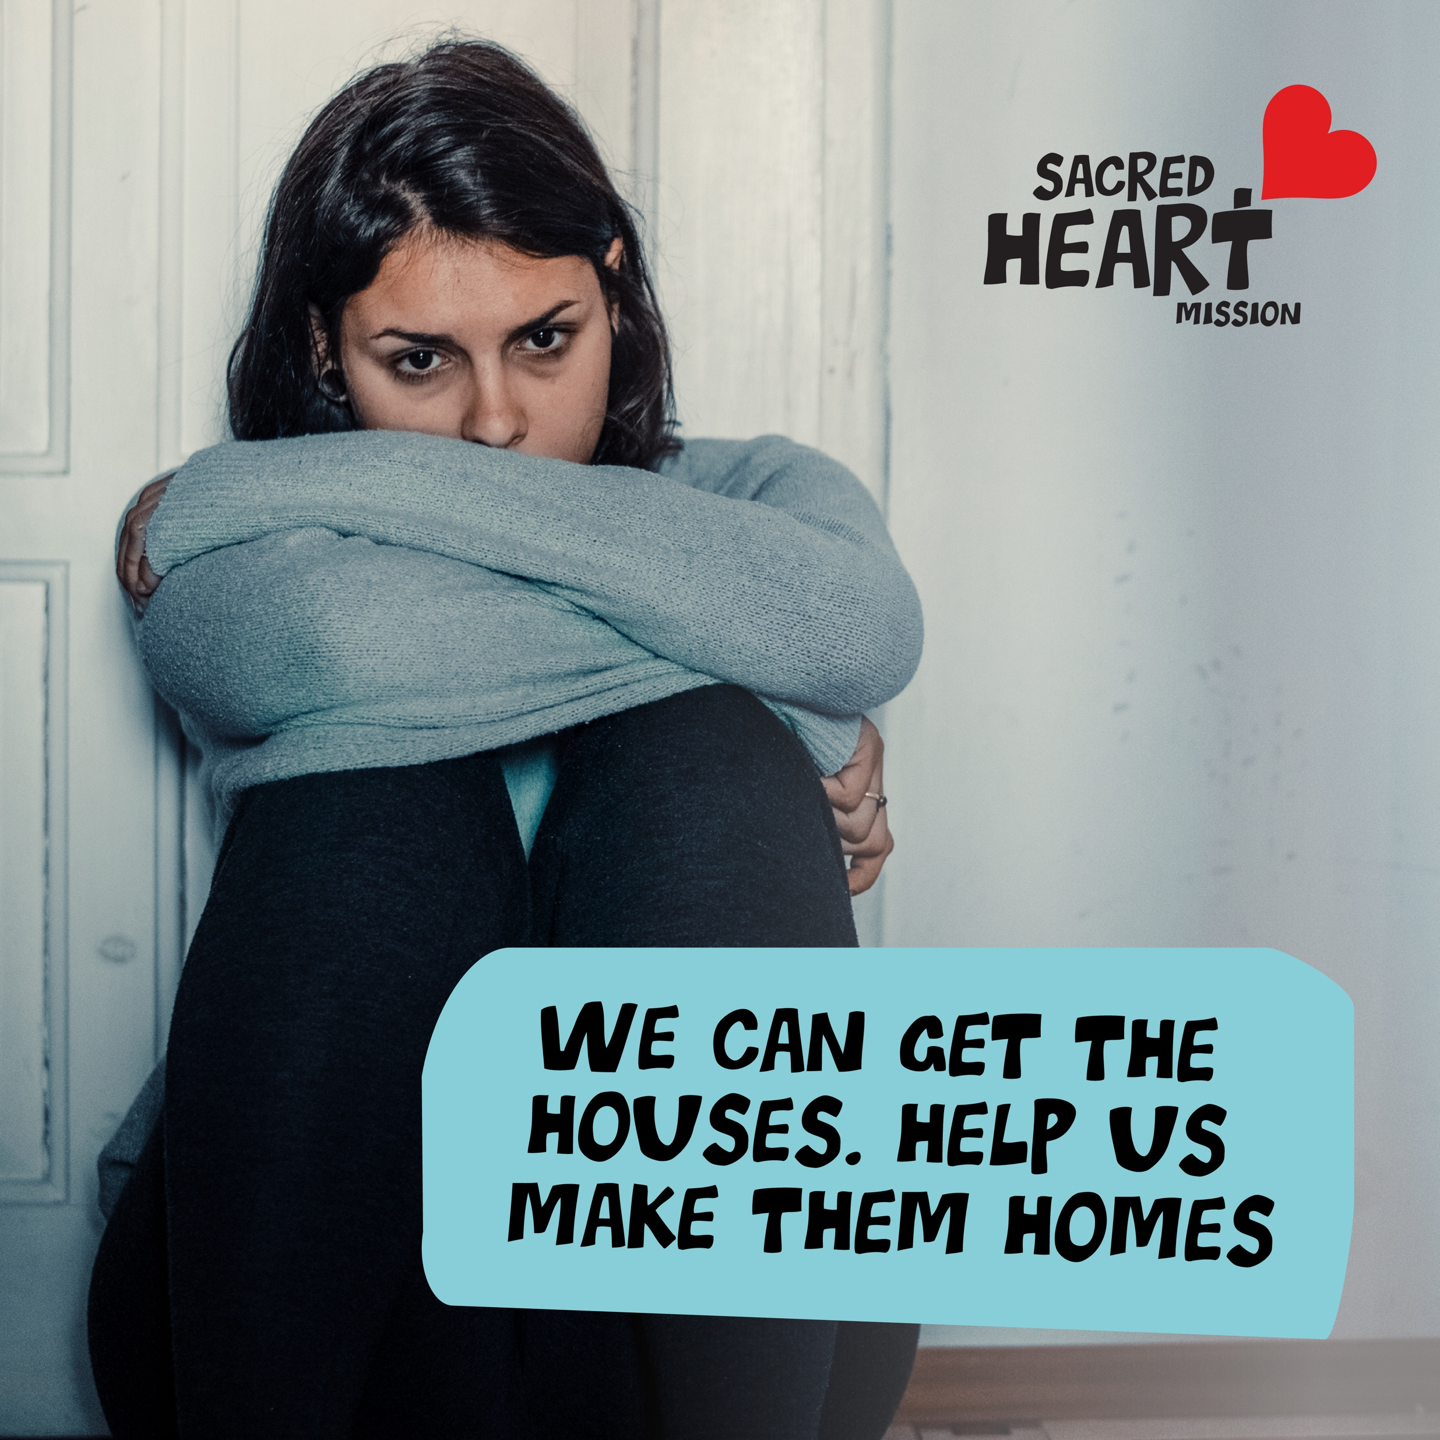
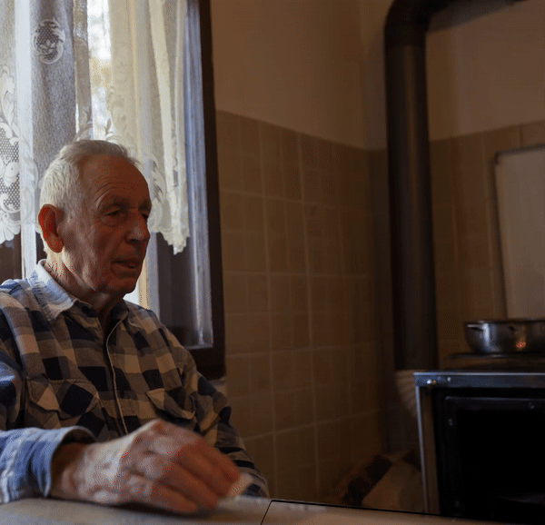
The moral of the story?
We were asking our potential donors to do too much work!

Slide 15
Back to basics

Slide 16
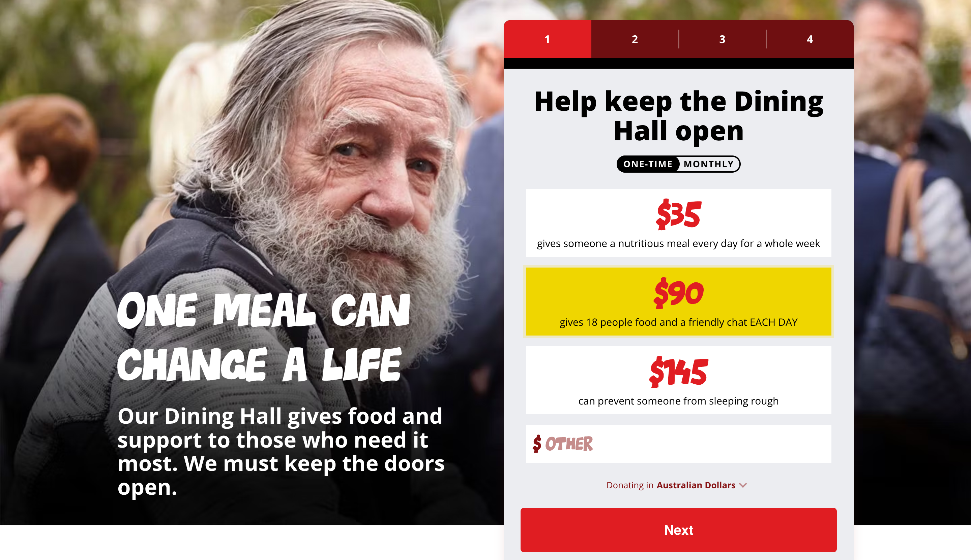
Back to basics

Slide 17
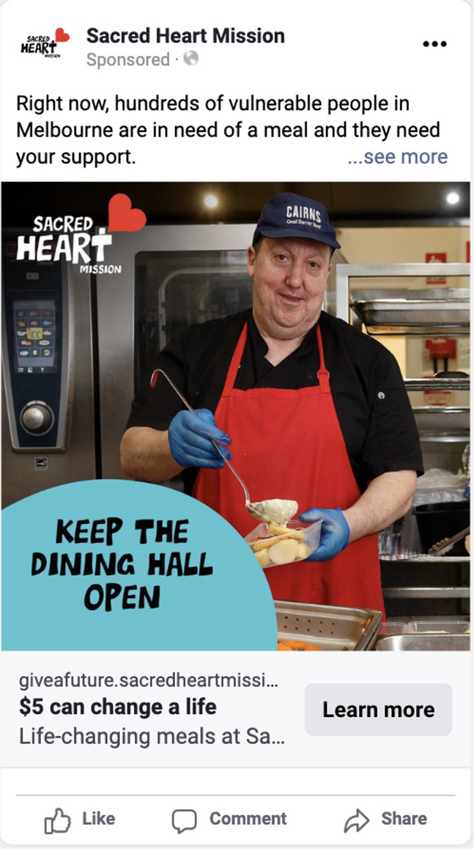
THE RESULTS
$27,797 media spend
317 one-off gifts
27 monthly gifts
$21,751 raised
$96 cost per donor
154 donations
$71 CPA
Year 1 return on ad spend = 0.95

Slide 18
Digital Acquisition
Direct to donation
Do as much heavy lifting as possible for your potential donors
You need the right images
Leverage your brand
Plan to fail
Don't reinvent the wheel
It's not the time or the place to raise awareness or educate

Slide 19
Dan and Andy’s take aways
Is it worth it?
What if my campaign tanks?
Do I have to make it work?
The importance of learning.
Bring in the expertise.
Start small and plan for the future.

Slide 20
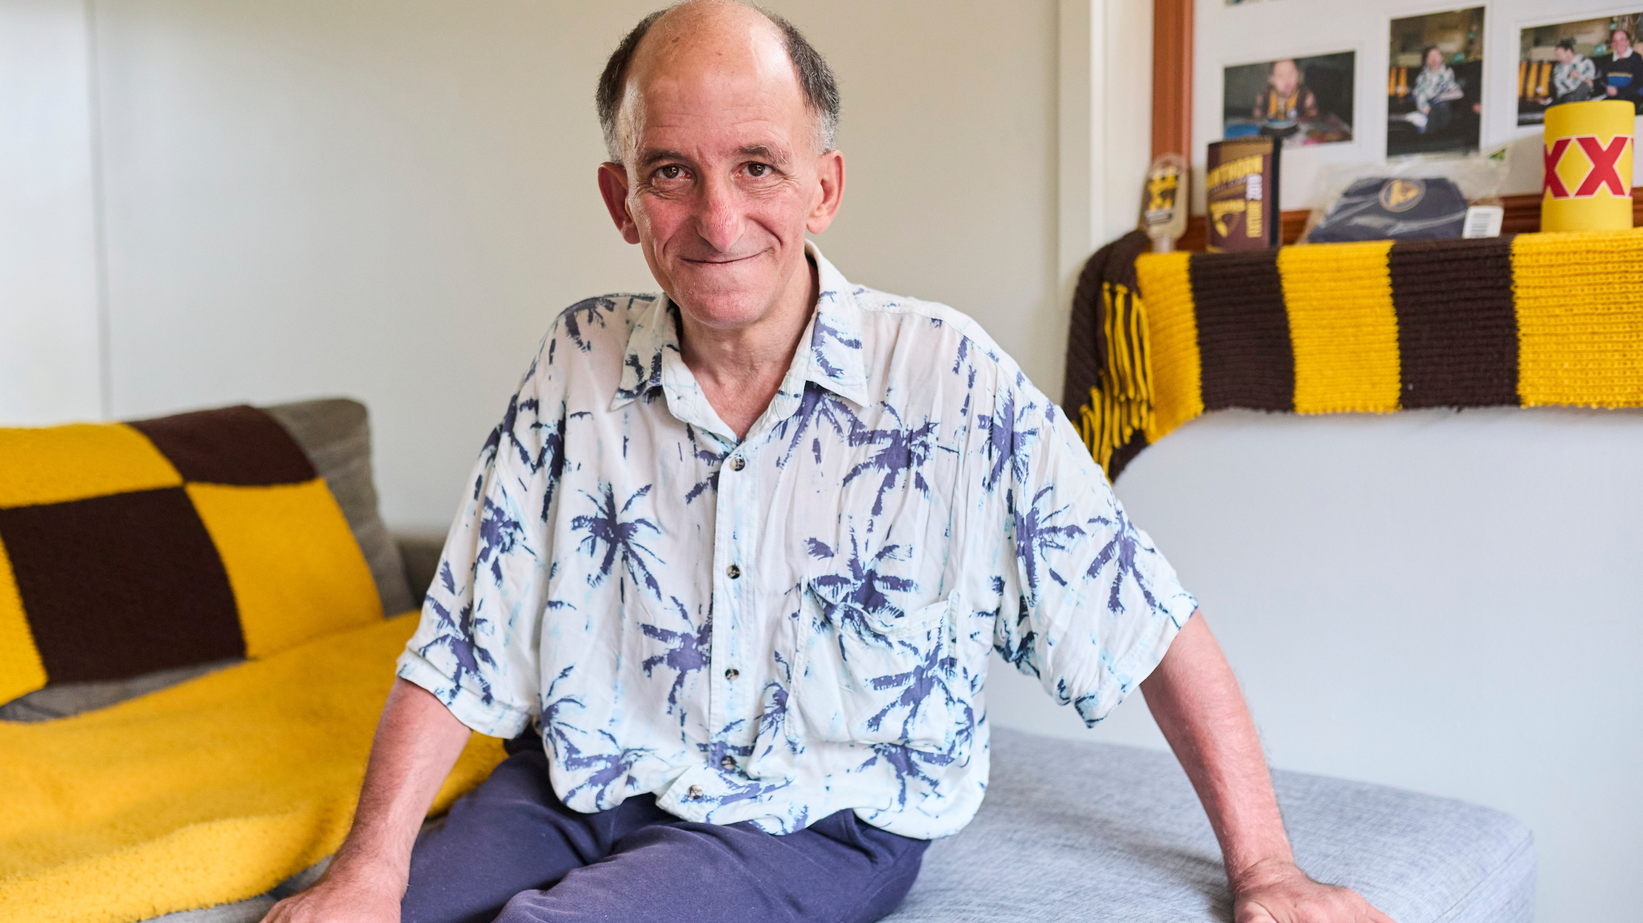
Thank You

